Slide 1
PHP
Chapter 19: PHP
By: Dr. Qusai Abuein

Slide 2
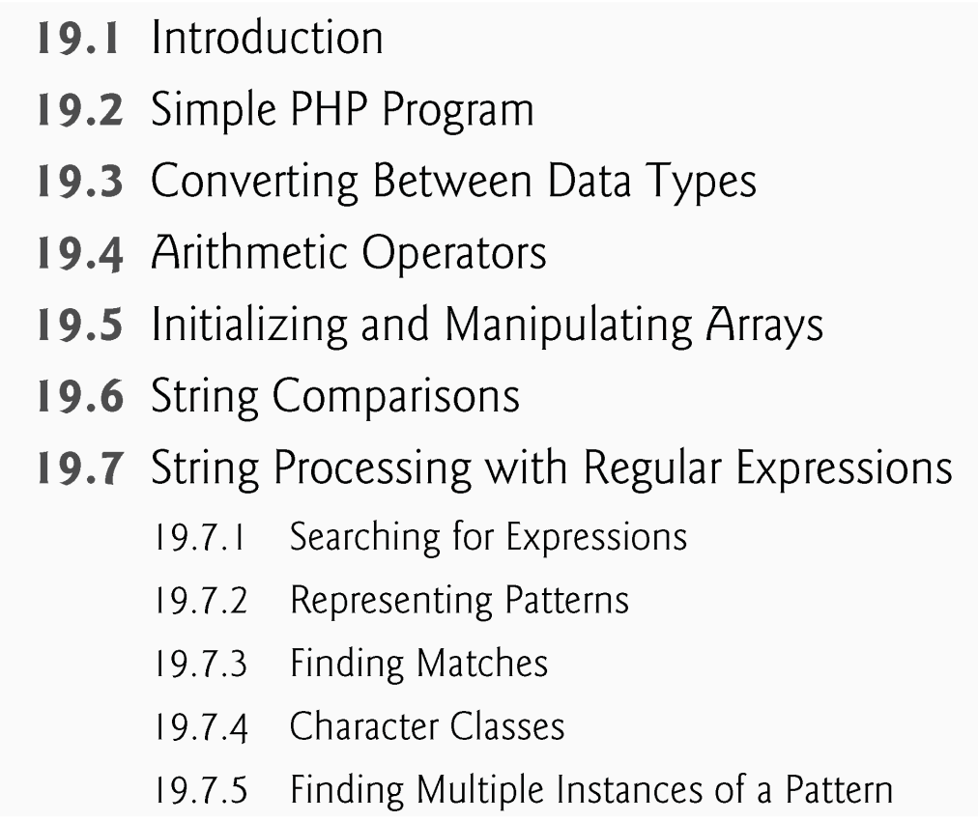
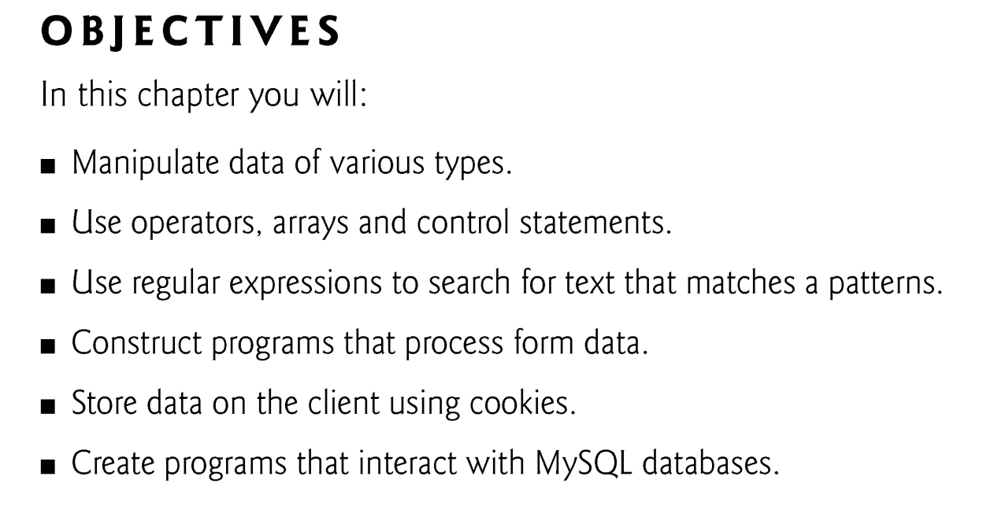
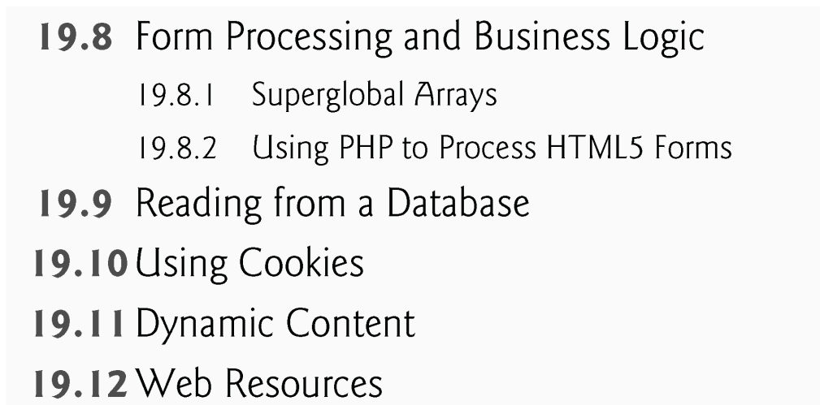

Slide 3
19.6 String Comparisons
Many string-processing tasks can be accomplished using the equality and relational operators (==, !=, <, <=, > and >=).
Function strcmp compares two strings. The function returns -1 if the first string alphabetically precedes the second string, 0 if the strings are equal, and 1 if the first string alphabetically follows the second.

Slide 4
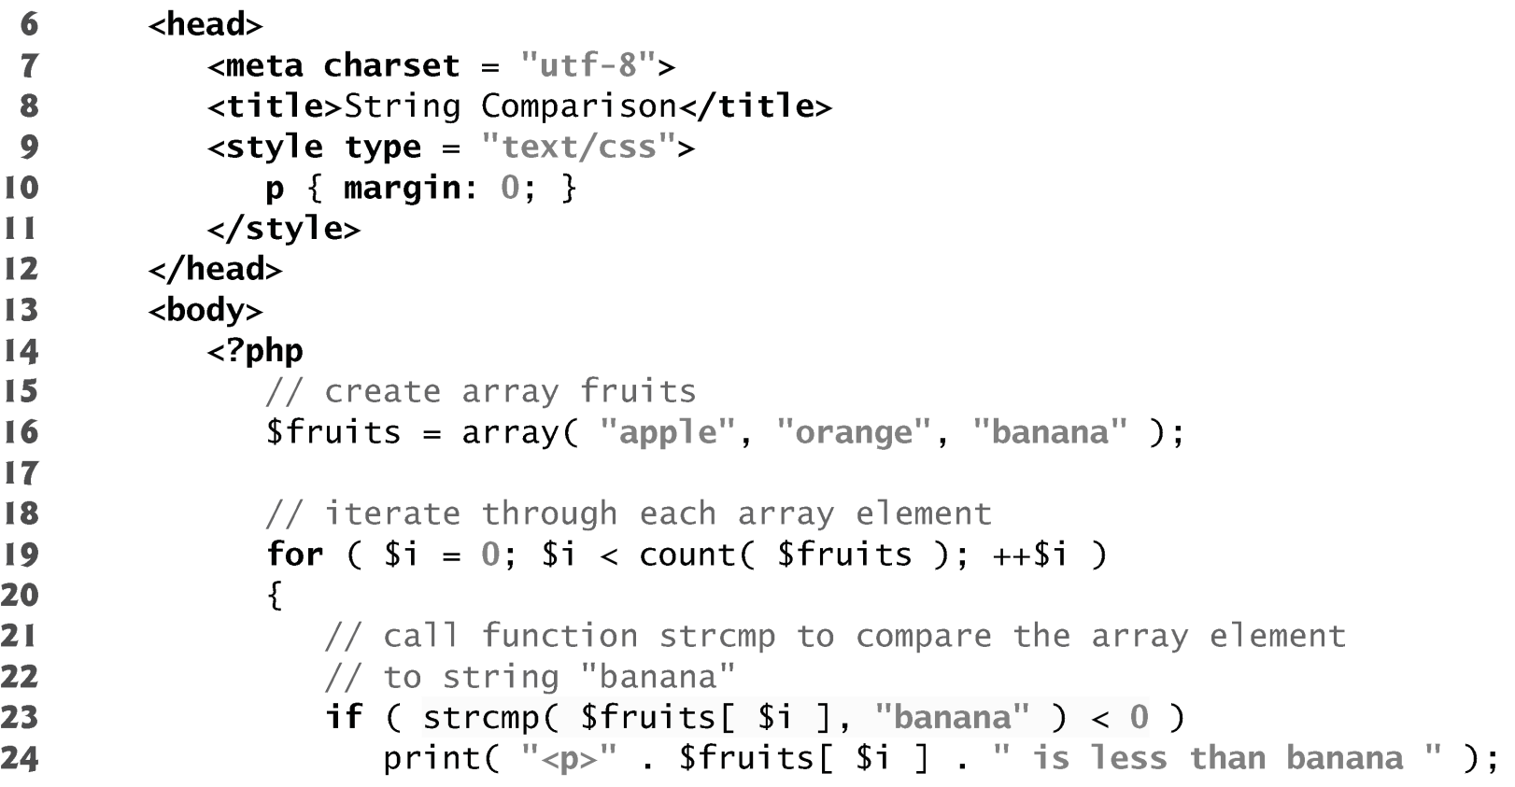
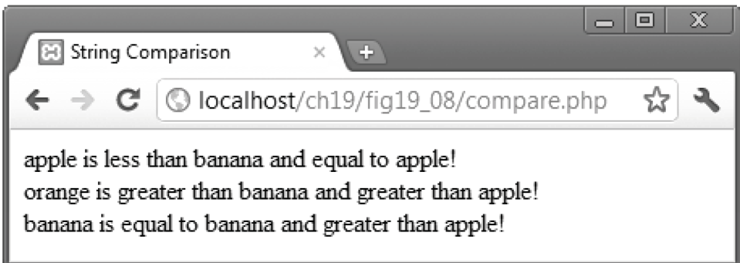
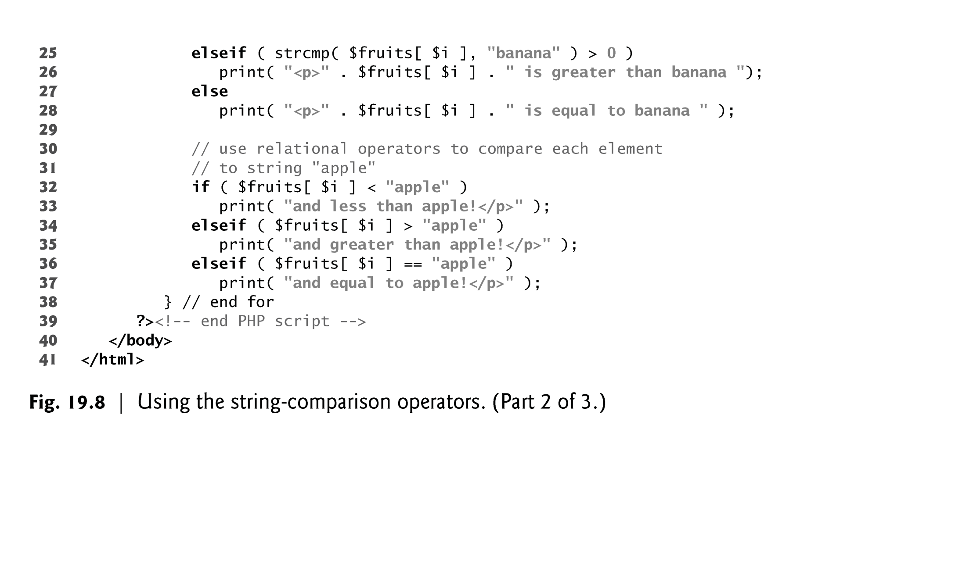

Slide 5
19.7 String Processing with Regular Expressions
Text manipulation is usually done with regular expressions—a series of characters that serve as pattern-matching templates (or search criteria) in strings, text files and databases.
Function preg_match uses regular expressions to search a string for a specified pattern using Perl-compatible regular expressions (PCRE).
If a pattern is found, preg_match returns the length of the matched string—which evaluates to true in a boolean context.
Anything enclosed in single quotes in a print statement is not interpolated, unless the single quotes are nested in a double-quoted string literal.
Function preg_match takes two arguments—a regular-expression pattern to search for and the string to search.
Function preg_match performs case-insensitive pattern matches.

Slide 6
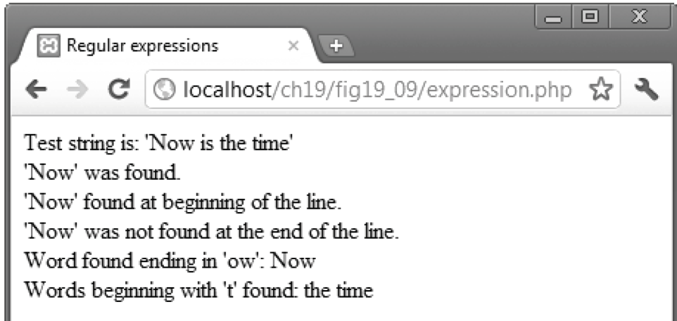
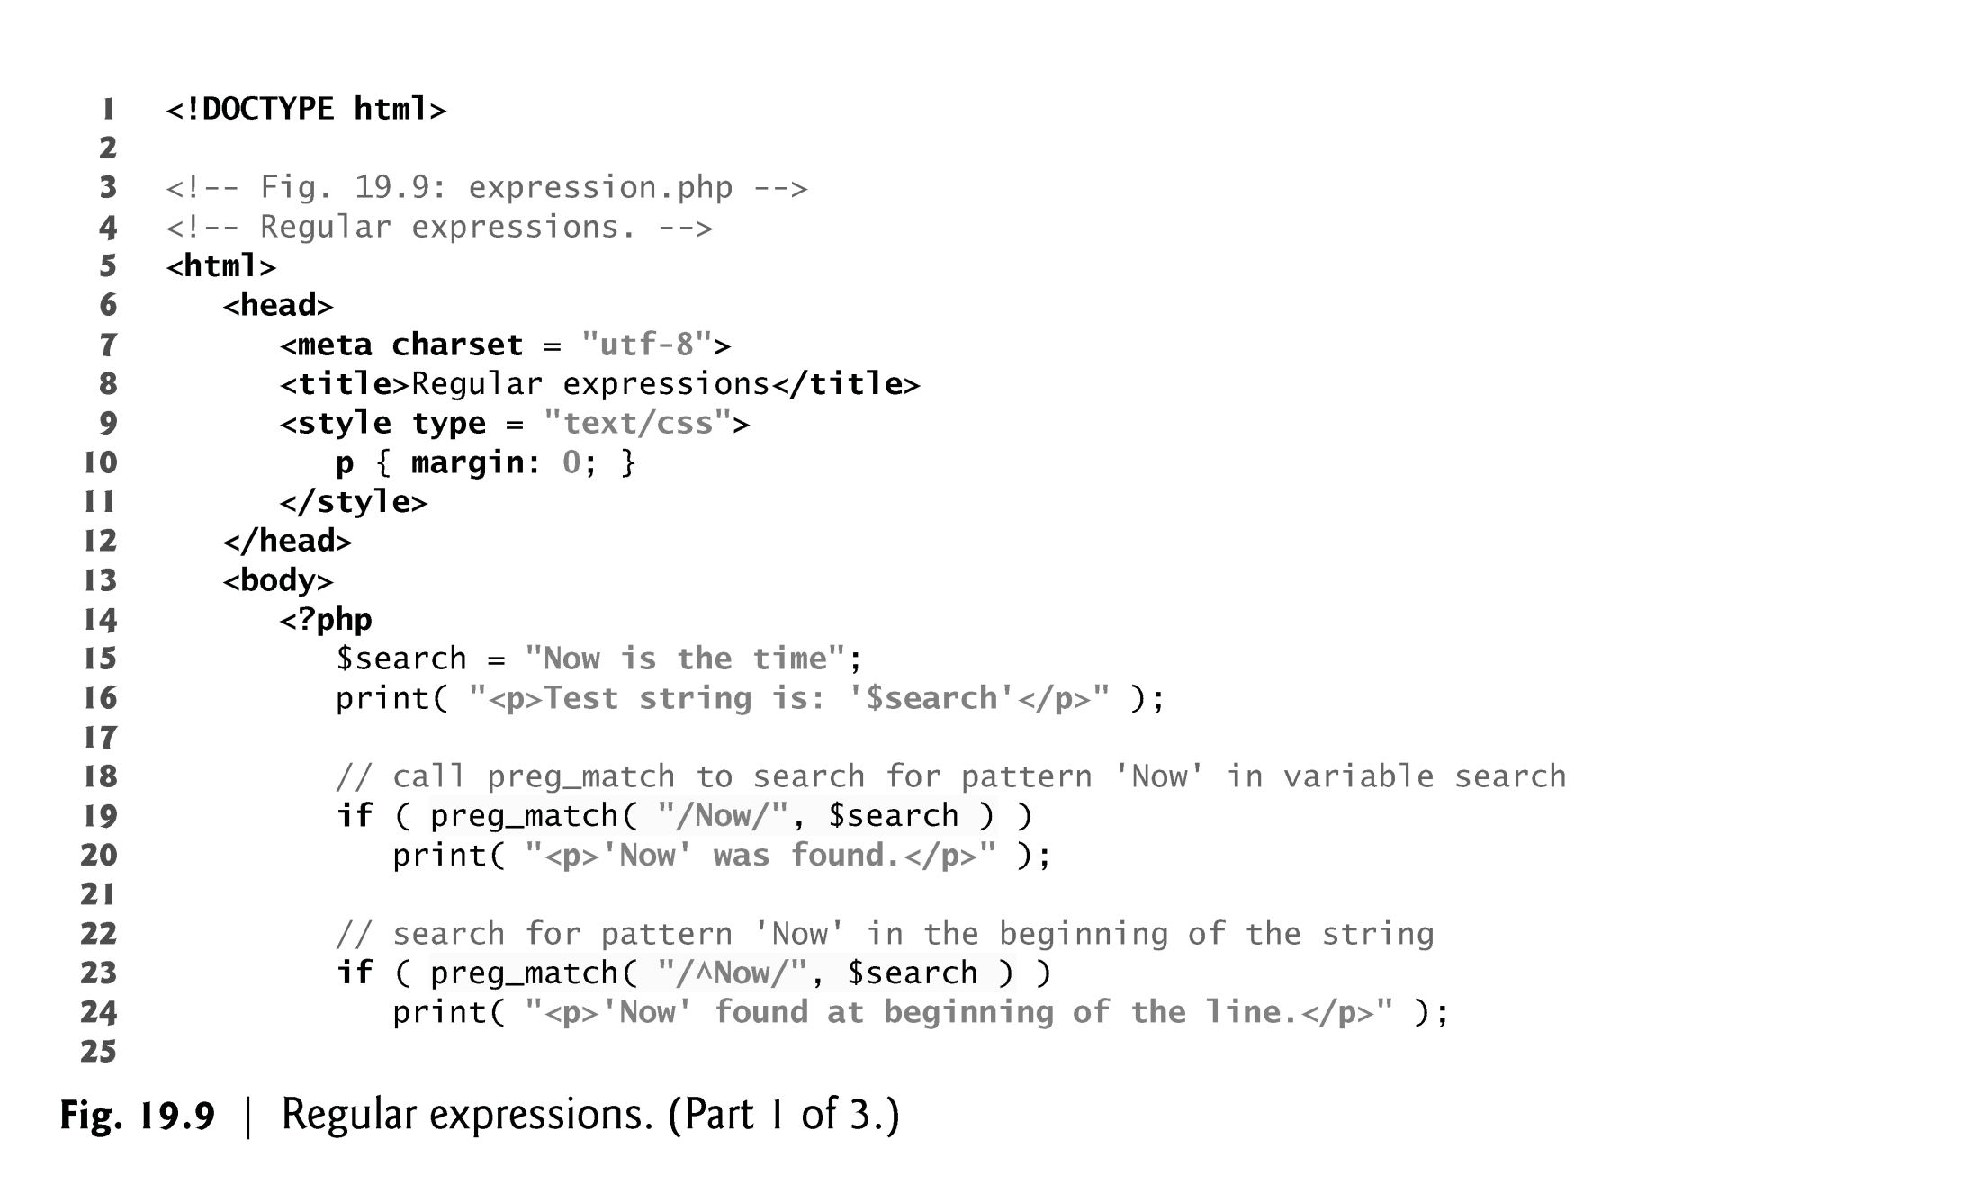

Slide 7
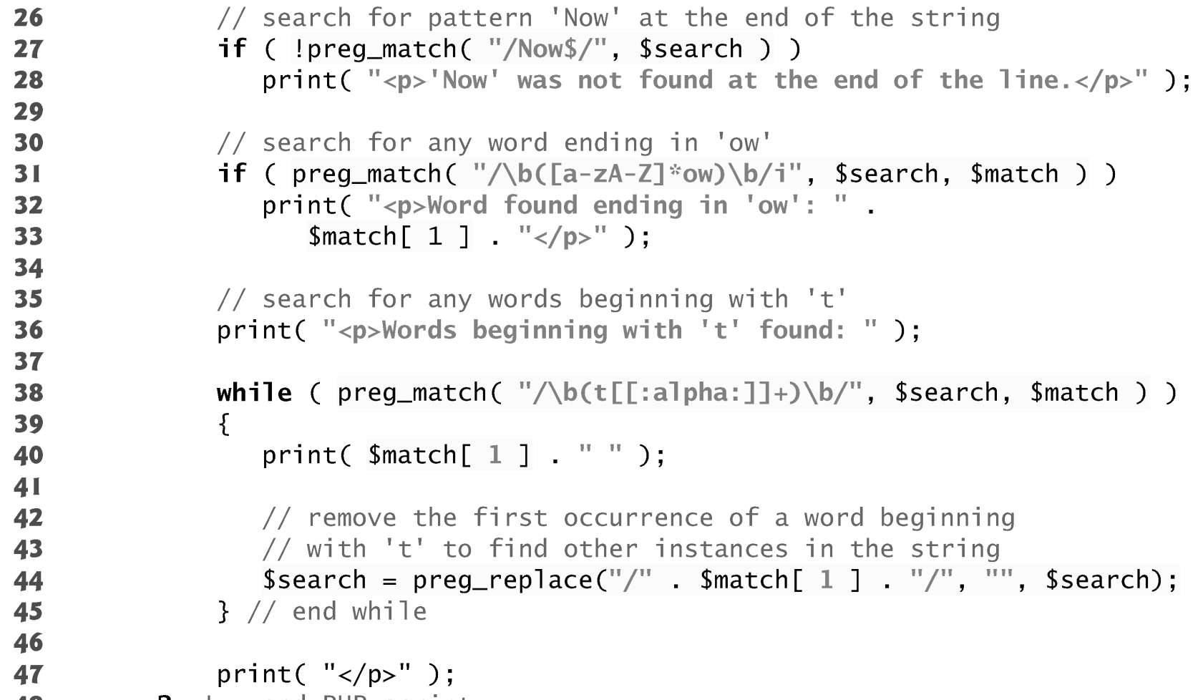

Slide 8
19.7.2 Representing Patterns
Regular expressions can include metacharacters such as ^, $ and . that specify patterns.
For example, the caret (^) metacharacter matches the beginning of a string, while the dollar sign ($) matches the end of a string.
The period (.) metacharacter matches any single character.
Bracket expressions are lists of characters enclosed in square brackets ([]) that match any single character from the list.
Ranges can be specified by supplying the beginning and the end of the range separated by a dash (-).

Slide 9
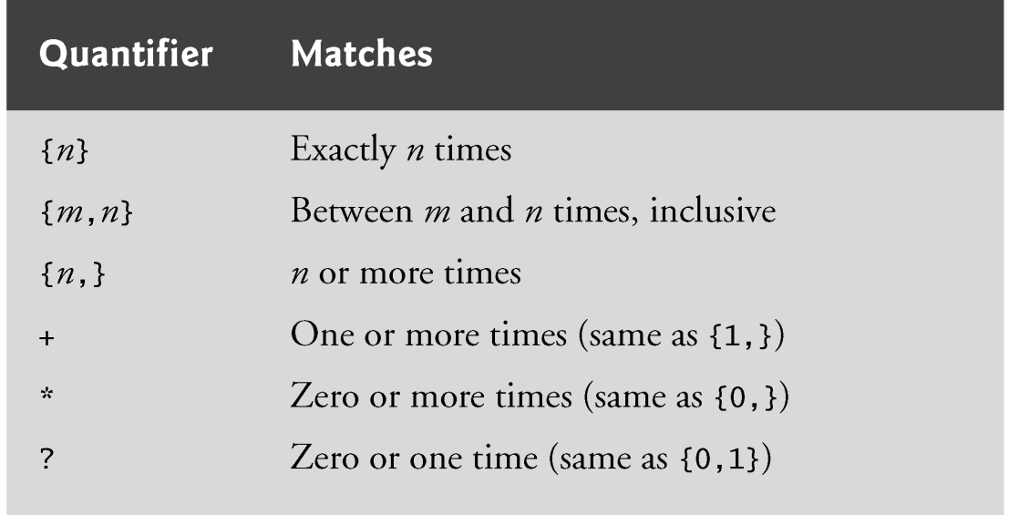
19.7.2 Representing Patterns
The \b before and after the parentheses indicates the beginning and end of a word, respectively—in other words, we’re attempting to match whole words.
Quantifiers are used in regular expressions to denote how often a particular character or set of characters can appear in a match.

Slide 10
19.7.3 Finding Matches
The optional third argument to function preg _match is an array that stores matches to each parenthetical statement of the regular expression.
The first element stores the string matched for the entire pattern, and the remaining elements are indexed from left to right.
To find multiple instances of a given pattern, we must make multiple calls to preg_match, and remove matched instances before calling the function again by using a function such as preg_replace.

Slide 11
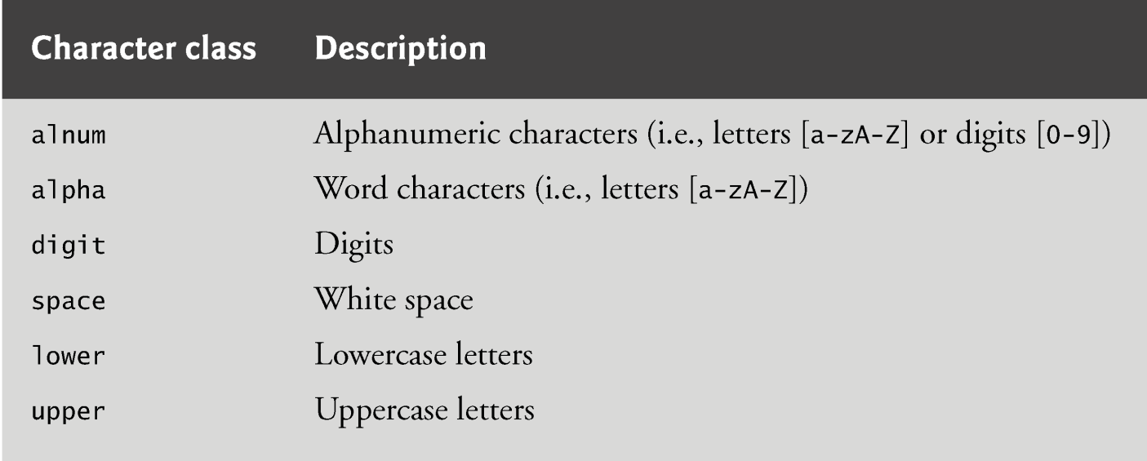
19.7.4 Character Classes
Character classes are enclosed by the delimiters [: and :].
When this expression is placed in another set of brackets, it is a regular expression matching all of the characters in the class.
A bracketed expression containing two or more adjacent character classes in the class delimiters represents those character sets combined.

Slide 12
19.7.5 Finding Multiple Instances of a Pattern
Function preg_replace takes three arguments—
the pattern to match,
a string to replace the matched string and
the string to search. The modified string is returned.

